Slide 1

Cybersecurity Website Hardening Project: Milestone 3 Report Team 3 November 12
IT4983
Page 1
Jack Pursley, Robin Tandongfor, Elijah Van Dorn, Valentine Wairimu, and Kylah Wilson

Slide 2
Page 2
Overview
Milestones Summary
Milestone Assessment
Milestone Deliverables
Red Team/Blue Team Challenges
Updated Gantt Chart

Slide 3
Page 3
Project Milestone 1 Summary
Created Project Plan
Researched security tools and ran the server.
Completed a Server Infrastructure Assessment
Began to create risk mitigation plan
Made updated to project plan and Gant Chart.
Notes:
Prevent MIME Sniffing: Stops browsers from interpreting files as a different MIME type than hat is specified, helping prevent certain attacks
XSS Protection: adds a layer of defense against cross-site scripting attacks
HSTS: forces he use of HTTPS, improving the security of communication between the server and clients
ModSecurity: A web application firewall to block and mitigate various types of web attacks.

Slide 4
Page 4
Project Milestone 2 Summary
Updates were made to the Gant Chart and the Project Plan
Security Policy, Access management policy, risk mitigation plan were created.
There were many updates made to the server including:
Password change
DNSSEC was enabled and the Kernel Hardening Key Pairs were updated
Downloaded Squid Daemon Service
Apache Security Headers
Downloaded Modsecurity
Notes:
Prevent MIME Sniffing: Stops browsers from interpreting files as a different MIME type than hat is specified, helping prevent certain attacks
XSS Protection: adds a layer of defense against cross-site scripting attacks
HSTS: forces he use of HTTPS, improving the security of communication between the server and clients
ModSecurity: A web application firewall to block and mitigate various types of web attacks.
By enabling DNSSEC, the server ensures more secure communication, preventing attacks such as DNS spoofing.
Kernel hardening refers to making the operating system's core (the kernel) more secure, often by using techniques that reduce vulnerabilities. Updating kernel hardening key pairs involves enhancing cryptographic measures that protect kernel-level operations, making it more difficult for attackers to exploit the system.
The Squid Daemon Service is a caching and forwarding web proxy. Squid improves the performance of web servers by caching repeated requests and is often used to control internet access in a network, enforce security policies, or optimize web traffic.
These are HTTP headers configured in the Apache web server to improve security by controlling how browsers handle the website's content.

Slide 5
Page 5
Project Milestone 3 Summary
Red/ Blue Team Activity
Red Team completed a stealth scan
Blue Team completed a penetration test on IP address with NMap
Encountered a Brute Force Attack on server, and the firewall was briefly disabled.
The team was individually sent an email asking for our server name and password.
There were very minor updates to the project plan.
Gant chart has been updated
Notes:
Prevent MIME Sniffing: Stops browsers from interpreting files as a different MIME type than hat is specified, helping prevent certain attacks
XSS Protection: adds a layer of defense against cross-site scripting attacks
HSTS: forces he use of HTTPS, improving the security of communication between the server and clients
ModSecurity: A web application firewall to block and mitigate various types of web attacks.
A brute force attack is a hacking method used to gain access to a system or account by systematically trying all possible combinations of passwords or encryption keys until the correct one is found. It relies on trial and error, often using automated tools to speed up the process.

Slide 6

Milestone Assessment Deliverables
Page 6
Red Team Logs (Offense)
Blue Team Logs (Defense)

Slide 7
Page 7
Red Team Log
Stealth Scan Definition:
In penetration testing a Stealth Scan is a technique used to gather information about a target system or network without raising suspicion by minimizing the footprint of the scan, essentially trying to avoid alerting the system administrator or intrusion detection systems by using subtle methods to search for open ports and vulnerabilities.
Examples of Commands:
1.) nmap –T4 <insert target Ip address>
2.) nmap -D RND:5 <target-IP>
Notes:
Commands:
1.) sends packets at a slow rate which helps to evade Intrusion Detection Systems (IDS) and Intrusion Prevention Systems (IPS) because these systems might interpret your traffic as normal background traffic. It starts with -T5 then goes to -T0. -T0 is EXTREMELY slow, so not useful whenever scanning thousands.
2.) -D sends packets from multiple decoy IP addresses a long with your real IP address. It creates confusion for IDS and IPS systems by making it difficult to determine the true source of the scan. While this technique helps evade detection, it is not foolproof.

Slide 8
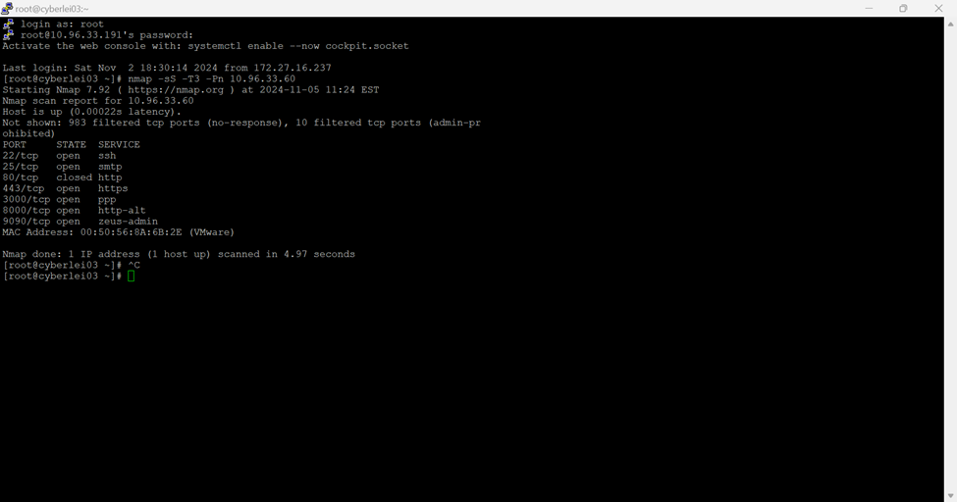
Page 8
Red Team Log
Stealth Scan Results:
Notes:
Results of our Stealth Scan

Slide 9
Page 9
Red Team Log
Stealth Scan Results:
Open Ports:
22/tcp (SSH): The Secure Shell (SSH) service is running. This allows remote login and command execution.
25/tcp (SMTP):
The Simple Mail Transfer Protocol (SMTP) service is open. This is typically used for email transmission. Open SMTP can sometimes be misconfigured, leading to vulnerabilities like open relays.
443/tcp (HTTPS):
Hypertext transfer protocol secure: primary protocol used to send data between a web browser and a website.
The server is running a secure web service using HTTPS (encrypted HTTP). This implies the server is set up to handle secure communications.
Notes:
Explanation Port 22:
is associated with the Secure Shell (SSH) protocol, which allows secure remote login and command execution on the server. This service is crucial for system administration as it provides encrypted communication channels.
Potential Risks: If vulnerabilities are present, such as weak or default passwords or outdated software, attackers could gain unauthorized access to the server. This could lead to further exploitation, data theft, or system compromise.
Explanation: Port 25 is used for the Simple Mail Transfer Protocol (SMTP), which is essential for sending and receiving email. While commonly found on mail servers, it may also be present on multi-functional servers.
Potential Risks: Open SMTP services if misconfigured can be posed as a vulnerability. This might allow open relay attacks, where unauthorized users can send spam or phishing emails through the server.
Explanation: Port 443 is used for HTTPS, which is the secure version of HTTP, allowing encrypted communication between the server and clients. This indicates the server can handle secure web traffic, such as e-commerce transactions or sensitive data transmission.
Potential Risks: Although HTTPS provides encryption, potential weaknesses could arise from misconfigured SSL/TLS settings (Secure Sockets Layer and Transport Layer Security. It's a communication protocol that allows devices to securely communicate with each other over the internet) such as weak cipher suites (a collection of algorithms that are used to secure a network connection) or support for outdated protocols.

Slide 10
Page 10
Red Team Log
Stealth Scan Results:
Exploiting Open ports: SSH port 22:
Objective: The objective of exploiting SSH (Secure Shell) port 22 using a brute-force attack is to gain unauthorized access to a target server or system by systematically guessing the username and password combinations.
Brute force attack
Steps:
1.Downloaded Medusa
2. Created userlist.txt
3. Create passlist.txt
4. Attempt 1: Medusa is unable to load the SSH module (ssh.mod) necessary to perform the attack.
5. Attempt 2: Medusa is having trouble establishing an SSH session with the target server at 10.96.33.60.
Notes:
Explaining Attempts:
Attempt 1: If Medusa cannot load the ssh.mod, it means that the tool is not configured properly or that the module is missing from the tool's installation. Without this module, Medusa cannot perform any brute-force or testing activities on SSH.
Fixed this by ensuring ssh.mod module is correctly installed and located in Medusa’s module directory.
Attempt 2: Medusa is having trouble establishing an SSH session with the target server

Slide 11
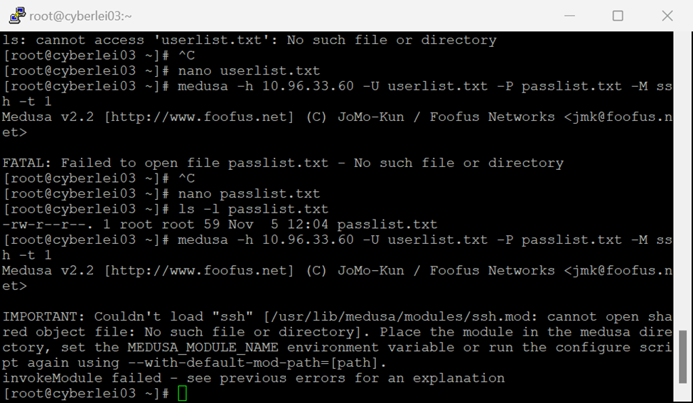
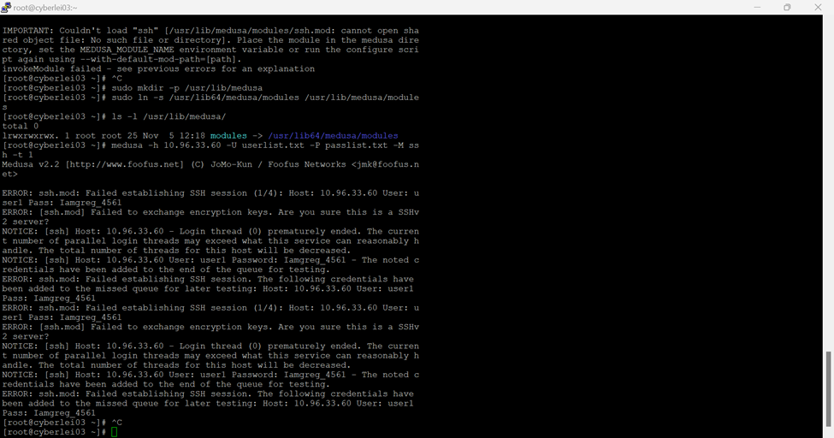
Page 11
Red Team Log
Stealth Scan Results:
Exploiting SSH port 22:
Attempt 1
Attempt 2

Slide 12
Page 12
Red Team Log
Stealth Scan Results:
Exploiting Open Ports: 25/tcp (SMTP):
Objective: Determines if the server allows relaying emails from unauthorized users, which could lead to spam exploitation.
Expected Outcome: If the scan confirms an open relay, it indicates a vulnerability that could be exploited to send spam or malicious emails.
Steps:
Command used: nmap -p 25 --script smtp-open-relay -T2 10.96.33.60
*This command will help identify whether the target’s SMTP server is vulnerable to open relay attacks.

Slide 13
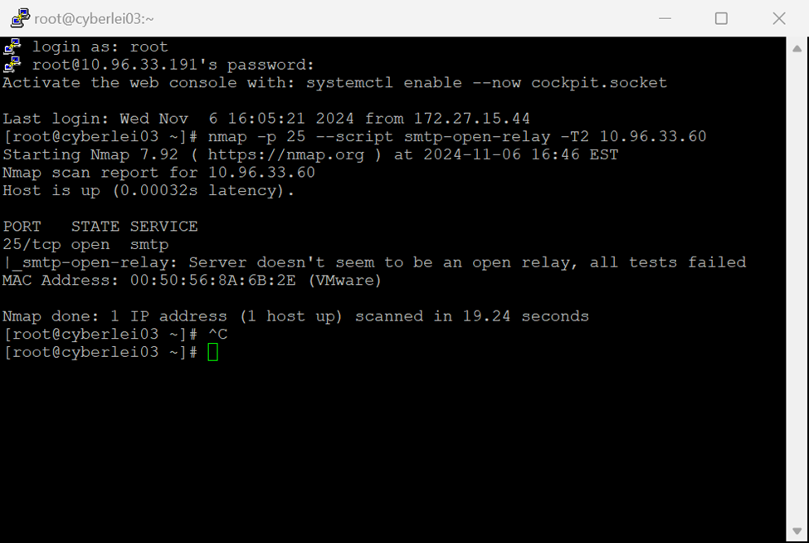
Page 13
Red Team Log
Stealth Scan Results:
Exploiting Open Ports: 25/tcp (SMTP):
Result indicate that the SMTP server on port 25 for the IP 10.96.33.60 does not allow open relay, which is a positive sign in terms of email security.

Slide 14
Page 14
Red Team Log
Stealth Scan Results:
Exploiting Open Ports: 443/tcp (HTTPS):
Objective: to evaluate the server's HTTPS service (on port 443) for potential weaknesses in its SSL/TLS configuration. (Secure sockets layer and transport layer security. It is a protocol or communication rule that allows computer systems to talk to each other on the internet safely.)

Slide 15
Page 15
Red Team Log
Stealth Scan Results:
Exploiting Open Ports: 443/tcp (HTTPS):
Results: All ciphers are marked with an "A" rating, which typically means they are considered strong and secure according to current cryptographic standards. The server has strong SSL/TLS encryption with no immediate weaknesses.
It supports modern, secure cipher suites (AES, ECDHE, DHE, RSA) with high encryption strengths.

Slide 16
Page 16
Red Team Log
Stealth Scan Results:
Results Part 2:
1. Compression (NULL):
The scan shows NULL for compression, meaning that compression is disabled. Compression can sometimes lead to vulnerabilities. Cipher Preference (Server):
2.The cipher preference is set to "server," meaning the server dictates the choice of cipher during the handshake process, rather than allowing the client to choose. This is generally considered a good practice to ensure that stronger ciphers are prioritized.
3. Weakest Cipher Strength (A):
The weakest cipher on the server is also rated "A," which means the server is configured with only strong ciphers and does not expose itself to weaker encryption methods.

Slide 17
Blue Team Log
Page 17
Brief Preparations
Pen-tested our IP address with Nmap and got a level 250 with TCP prediction sequence. It also could not determine our IP operating system.
1st Brute Force Attack
On October 21st, a user tried to get in using both admin names. They couldn't break though the password but did figure out how to run one command to disable the firewall briefly.
In this attack and one a couple weeks later, it was confirmed neither IP address was ours.

Slide 18
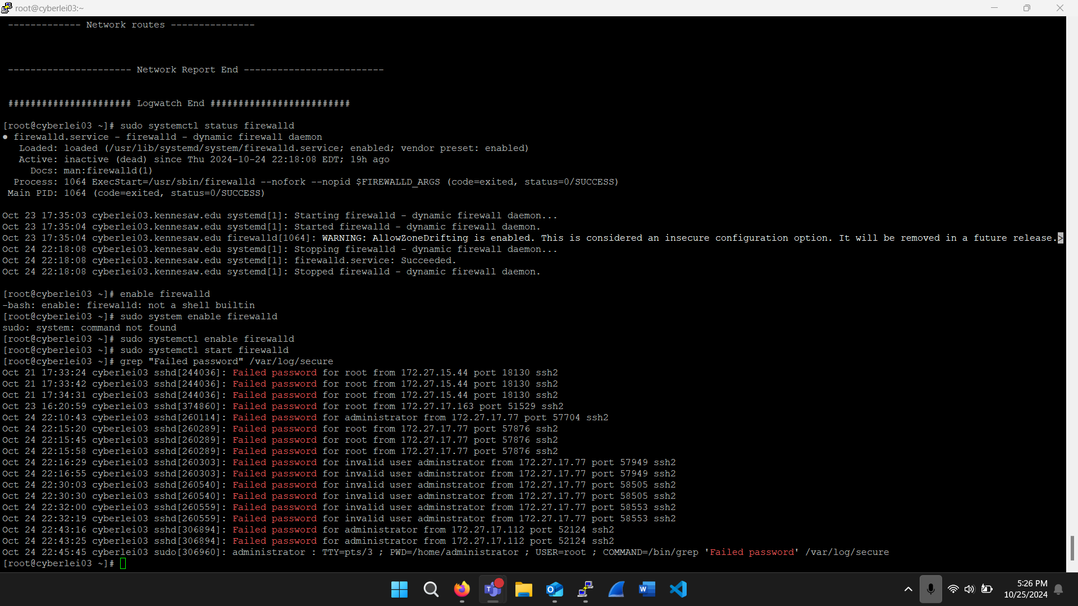
Blue Team Log
Page 18
First Brute force Attack

Slide 19
Blue Team Log
Page 19
Social Engineering Attack Attempt
On October 29th, each one of us received an email from a member of the team that targeted us. The person was pretending to be from the IT help desk and requested our server name and password.
Elijah was the first to let everyone know of this as he was sent the email first. It was important to make sure no one fell for the attack and let the opposing team into our server.

Slide 20
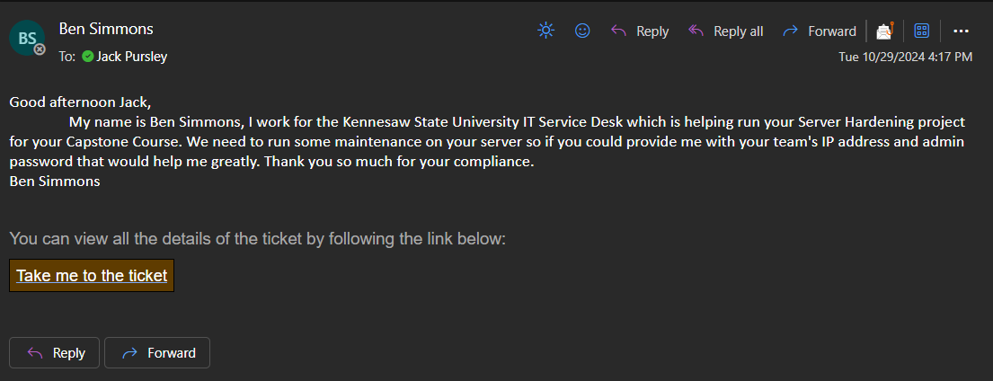
Blue Team Log
Page 20
Social Engineering Attack Attempt

Slide 21
Blue Team Log
Page 21
Response
To counter this we enforced password use for the "sudo" command. This type of attack did not occur again.
We also installed Logwatch to run scans and alert us when seeing potential threats. This enhanced visibility over login attempts and patterns indicating system breaches.
Third Attack 11/04
This attack was shorter, but no less dangerous. The attacker tried to login but did not use the correct admin name.

Slide 22
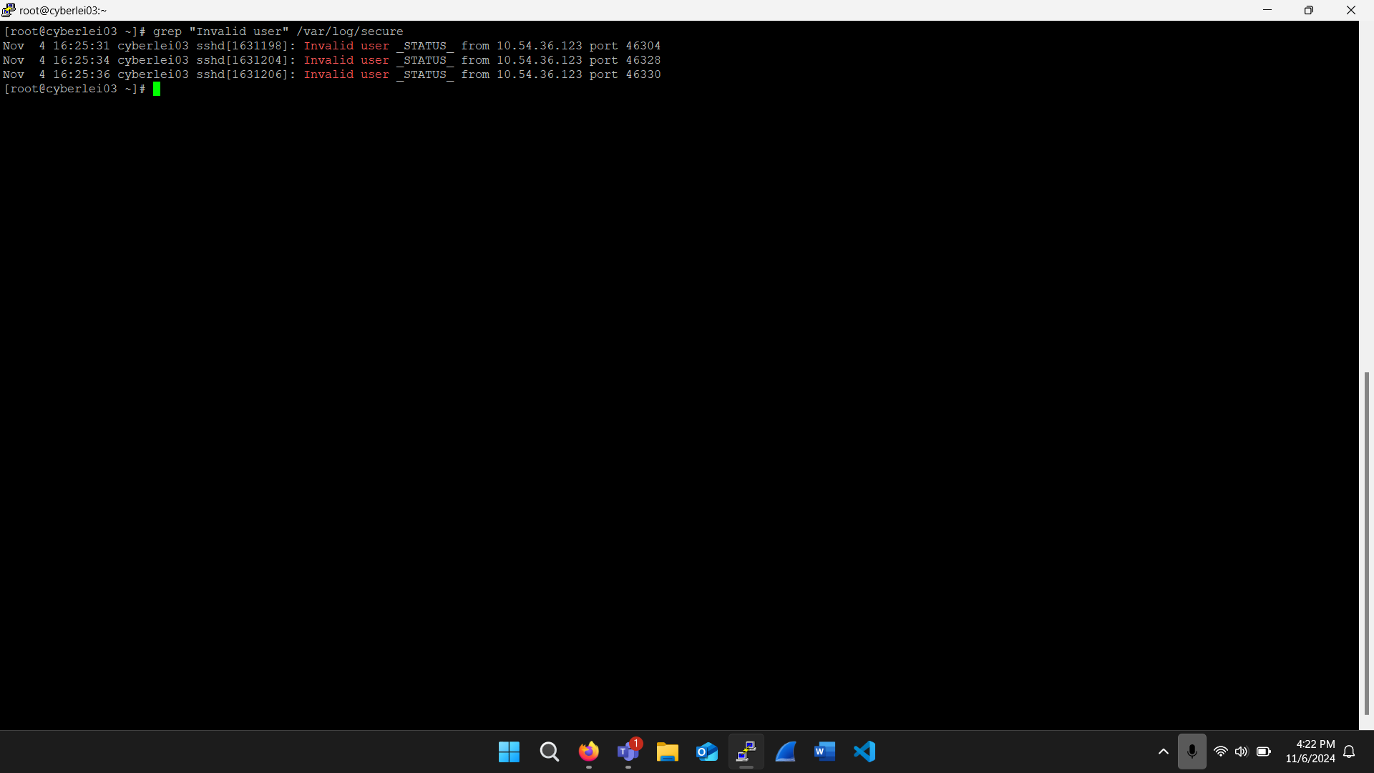
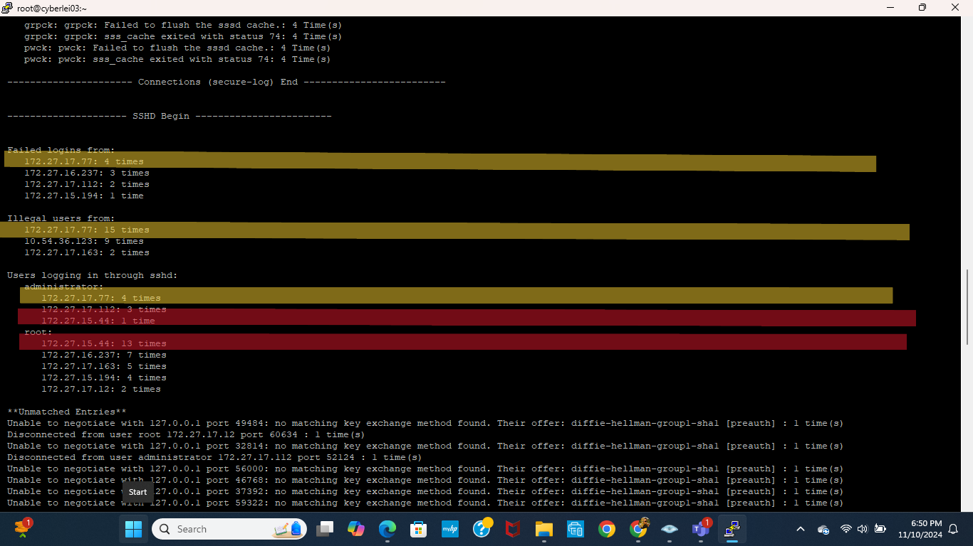
Blue Team Log
Page 22
Second Brute Force Attack
Logwatch Report (suspicious Ip's were noted)

Slide 23
Page 23
Milestone 3 Challenges
Tools & Access Challenges
Issues with Medusa’s SSH module hindered red-team brute-force attempts, and server defenses limited attack options.
Defense Measures
Blue team enforced sudo password use and added Logwatch to monitor for intrusions after brute-force and phishing attempts.
Team Coordination
Quick responses and communication were crucial in identifying phishing attempts and managing logs effectively.

Slide 24
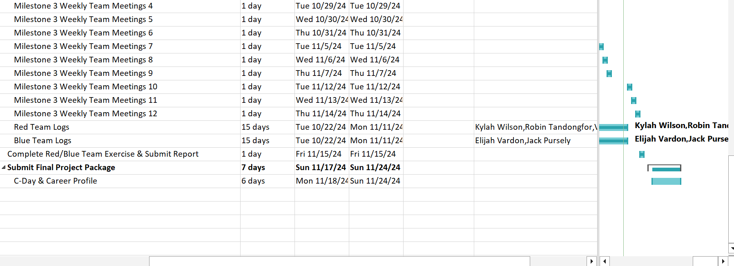
Updates to Gantt Chart
Page 25
Logged the final contributions of the Red/Blue Team Phase

Slide 27
Red/Blue Team Phase
Blue Team
Red Team
Pen-tested our IP address with Nmap
1st Brute Force Attack: On October 21st, a user tried to get in using both admin names
2nd Attack: Social Engineering Attempt
Third Attack 11/04: The attacker tried to login but did not use the correct admin name.
To counter this we enforced password use for the "sudo" command.
We also installed Logwatch to run scans and alert us when seeing potential threats.
Third Attack 11/04: The attacker tried to login but did not use the correct admin name.
Performed stealth scans
Identified open ports and potential vulnerabilities
Exploited open ports:
i.e. Brute Force Attack

